Slide 1

Capstone Project - The Battle of the Neighborhood
Prediction of an optimal location for a restaurant

Slide 2
Introduction
In this project we will try to find an optimal location for a restaurant.
Specifically, this report will be targeted to stakeholders interested in opening a French restaurant in Toronto, Canada.
Since there are lots of restaurants in Toronto we will try to detect locations that are not already crowded with restaurants.
We are also particularly interested in the areas with no French restaurants in the vicinity.
Advantages of each area will then be clearly expressed so that best possible final location can be chosen by stakeholders.

Slide 3
Data acquisition and cleaning
Following data sources will be needed to extract/generate the required information:
Wikipedia page: https://en.wikipedia.org/wiki/List_of_postal_codes_of_Canada:_M
Geographical coordinates of each neighborhood
Number of restaurants and their type and location in every neighborhood will be obtained using Foursquare API.
Cleaned data contains 103 samples and 5 features.

Slide 4
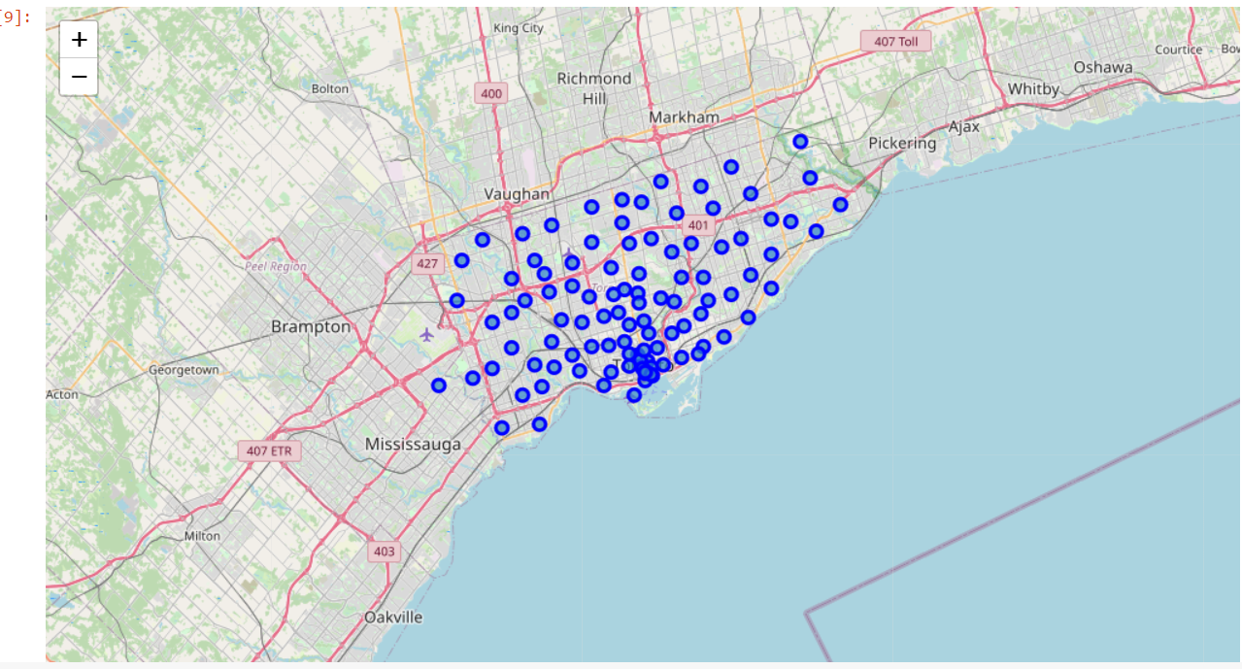
Data Visualization of the Neighborhoods

Slide 5
Conclusion and future directions
Purpose of this project was to identify central Toronto areas with low number of restaurants (particularly French restaurants) in order to aid stakeholders in narrowing down the search for optimal location for a new French restaurant.
By calculating restaurant density distribution from Foursquare data we have first identified neighborhoods that justify further analysis and then generated extensive collection of locations which satisfy some basic requirements regarding existing nearby restaurants.
Clustering of those locations was then performed in order to create major zones of interest (containing greatest number of potential locations) and addresses of those zone centers were created to be used as starting points for final exploration by stakeholders.
Final decision on optimal restaurant location will be made by stakeholders based on specific characteristics of neighborhoods and locations in every recommended zone, taking into consideration additional factors like attractiveness of each location (proximity to park or water), levels of noise / proximity to major roads, real estate availability, prices, social and economic dynamics of every neighborhood etc.

